Slide 1
K.R.POORNIMA
Data Visualization of Bird Strikes between 2000 – 2011

Slide 2
PROBLEM STATEMENT
Transport and communication are in the crucial domain in the field of analytics.Environmental impacts and safety are, nowadays, two major concerns of the scientificcommunity with respect to transport scenarios and to the ever-growing urban areas.These issues gain more importance due to the increasing amount of vehicles and people. Seeking new solutions is reaching a point where available technologies and artificial intelligence, especially MAS, are being recognized as ways to cope with and tackle these kinds of problems in a distributed and more appropriate way.
A bird strike is strictly defined as a collision between a bird and an aircraft which is inflight or on a take-off or landing roll. The term is often expanded to cover other wildlifestrikes - with bats or ground animals. Bird Strike is common and can be a significantthreat to aircraft safety. For smaller aircraft, significant damage may be caused to theaircraft structure and all aircraft, especially jet-engine ones, are vulnerable to the lossof thrust which can follow the ingestion of birds into engine air intakes. This has resulted in several fatal accidents.

Slide 3
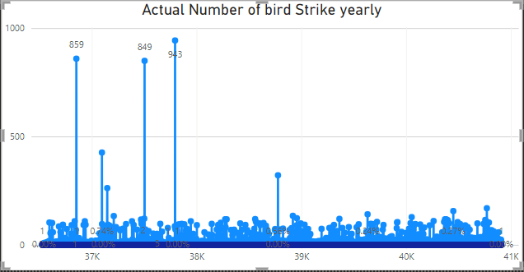

INSIGHTS
Total number of bird strikes is 58k took place between 2000 to 2011 which resulted in repair cost of 134 million.

Slide 4
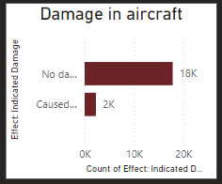
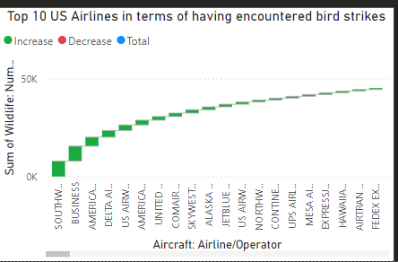
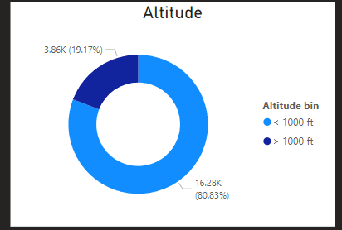
In the over all flight only 18,000 flights received no damage and 2000 flights had small to large scale damage.
Southwestern airlines,business,American airlines,delta airlines are more involved in bird stikes than the rest airline.
80% of the fligths were flying below 1000 feet and 19% were flying above 1000ft.

Slide 5
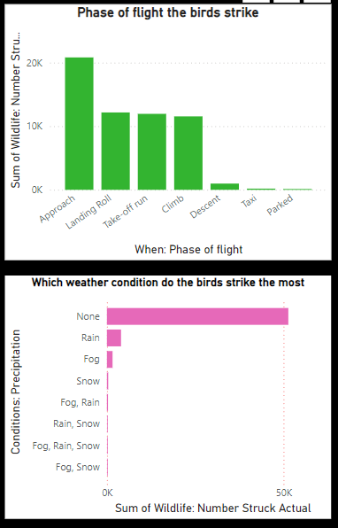
More strikes occurred while plane approached runway.
strike also took place while plane landing roll, take-off run and climb.
And while descent, taxi,parked there is nearly no strikes.
Rain,snow, fog has no relation with perspective of bird strikeand it is seen that bird strike happened when the weather was fine .

Slide 6
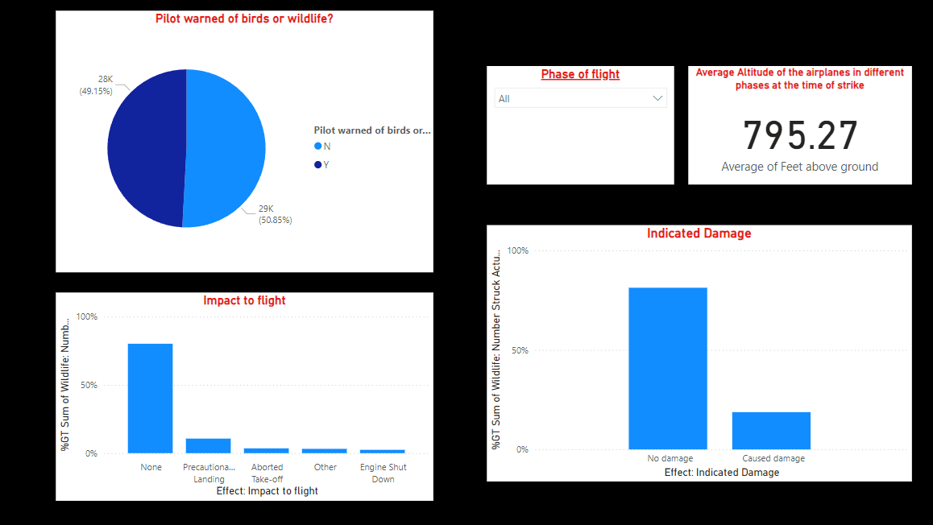
50% of the pilots were not informed of the possible bird strike. Whereas 49% of the pilots are informed .
The average altitude that the bird strike took place is 795.27.
10% bird strike resulted in precautionary landing .
3.25% caused aborted take off
2.45% caused engine shut down.
81.25% bird strike didn’t cause any damage to the flight.

Slide 7
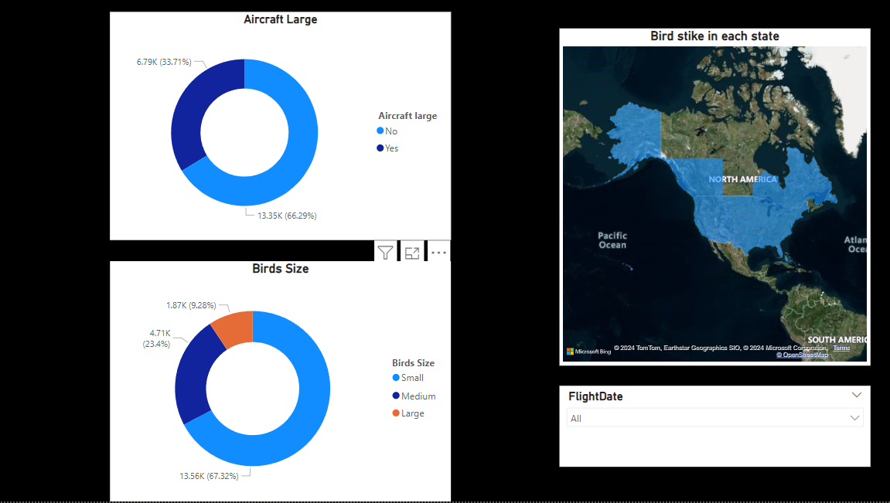
66% of the aircraft involved in bird strike was not large aircraft.
33% of the aircraft involved in bird strike is large.
Bird size was usually small while strike followed by medium and large.

